Slide 1
Proving the Correctness of Algorithms

Slide 2
Lecture Outline
Proving the Correctness of Algorithms
  Preconditions and Postconditions
  Loop Invariants
  Induction – Math Review
  Using Induction to Prove Algorithms

Slide 3
What does an algorithm ?
An algorithm is described by:
  Input data
  Output data
  Preconditions: specifies restrictions on input data
  Postconditions: specifies what is the result
Example: Binary Search
  Input data: a:array of integer; x:integer;
  Output data: found:boolean;
  Precondition: a is sorted in ascending order
  Postcondition: found is true if x is in a, and found is false otherwise

Slide 4
Correct algorithms
An algorithm is correct if:
  for any correct input data:
    it stops and
    it produces correct output.
  Correct input data: satisfies precondition
  Correct output data: satisfies postcondition

Slide 5
Proving correctness
An algorithm = a list of actions
Proving that an algorithm is totally correct:
  Proving that it will terminate
  Proving that the list of actions applied to the precondition imply the postcondition
  This is easy to prove for simple sequential algorithms
  This can be complicated to prove for repetitive algorithms (containing loops or recursivity)
    use techniques based on loop invariants and induction

Slide 6
Example – a sequential algorithm
Swap1(x,y):
aux := x
x := y
y := aux
Precondition:
x = a and y = b
Postcondition:
x = b and y = a
Proof: the list of actions applied to the precondition imply the postcondition
Precondition: x = a and y = b
aux := x => aux = a
x : = y => x = b
y := aux => y = a
x = b and y = a is the Postcondition

Slide 7
Example – a repetitive algorithm
Algorithm Sum_of_N_numbers
Input: a, an array of N numbers
Output: s, the sum of the N numbers in a
s:=0;
k:=0;
While (k<N) do
k:=k+1;
s:=s+a[k];
end
Proof: the list of actions applied to the precondition imply the postcondition
BUT: we cannot enumerate all the actions in case of a repetitive algorithm !
We use techniques based on loop invariants and induction

Slide 8
Loop invariants
A loop invariant is a logical predicate such that: if it is satisfied before entering any single iteration of the loop then it is also satisfied after the iteration

Slide 9
Example: Loop invariant for Sum of n numbers
Algorithm Sum_of_N_numbers
Input: a, an array of N numbers
Output: s, the sum of the N numbers in a
s:=0;
k:=0;
While (k<N) do
k:=k+1;
s:=s+a[k];
end
Loop invariant = induction hypothesis: At step k, S holds the sum of the first k numbers

Slide 10
Using loop invariants in proofs
We must show the following 3 things about a loop invariant:
Initialization: It is true prior to the first iteration of the loop.
Maintenance: If it is true before an iteration of the loop, it remains true before the next iteration.
Termination: When the loop terminates, the invariant gives us a useful property that helps show that the algorithm is correct.

Slide 11
Example: Proving the correctness of the Sum algorithm (1)
Induction hypothesis: S= sum of the first k numbers
Initialization: The hypothesis is true at the beginning of the loop:
  Before the first iteration: k=0, S=0. The first 0 numbers have sum zero (there are no numbers) => hypothesis true before entering the loop

Slide 12
Example: Proving the correctness of the Sum algorithm (2)
Induction hypothesis: S= sum of the first k numbers
Maintenance: If hypothesis is true before step k, then it will be true before step k+1 (immediately after step k is finished)
  We assume that it is true at beginning of step k: “S is the sum of the first k numbers”
  We have to prove that after executing step k, at the beginning of step k+1: “S is the sum of the first k+1 numbers”
  We calculate the value of S at the end of this step
  K:=k+1, s:=s+a[k+1] => s is the sum of the first k+1 numbers

Slide 13
Example: Proving the correctness of the Sum algorithm (3)
Induction hypothesis: S= sum of the first k numbers
Termination: When the loop terminates, the hypothesis implies the correctness of the algorithm
The loop terminates when k=n=> s= sum of first k=n numbers => postcondition of algorithm, DONE

Slide 14
Loop invariants and induction
Proving loop invariants is similar to mathematical induction:
  showing that the invariant holds before the first iteration corresponds to the base case, and
  showing that the invariant holds from iteration to iteration corresponds to the inductive step.

Slide 15
Mathematical induction - Review
Let T be a theorem that we want to prove. T includes a natural parameter n.
Proving that T holds for all natural values of n is done by proving following two conditions:
  T holds for n=1
  For every n>1 if T holds for n-1, then T holds for n
Terminology:
T= Induction Hypothesis
1= Base case
2= Inductive step

Slide 16
Mathematical induction - review
Strong Induction: a variant of induction where the inductive step builds up on all the smaller values
Proving that T holds for all natural values of n is done by proving following two conditions:
  T holds for n=1
  For every n>1 if T holds for all k<= n-1, then T holds for n

Slide 17
Mathematical induction – Example1
Theorem: The sum of the first n natural numbers is n*(n+1)/2
Proof: by induction on n
  Base case: If n=1, s(1)=1=1*(1+1)/2
  Inductive step: We assume that s(n)=n*(n+1)/2, and prove that this implies s(n+1)=(n+1)*(n+2)/2 , for all n>=1
  s(n+1)=s(n)+(n+1)=n*(n+1)/2+(n+1)=(n+1)*(n+2)/2

Slide 18
Example: Proving the correctness of the conversion algorithm
Induction hypothesis=Loop Invariant: If m is the integer represented by array b[1..k], then n=t*2^k+m
To prove the correctness of the algorithm, we have to prove the 3 conditions:
  Initialization: The hypothesis is true at the beginning of the loop
  Maintenance: If hypothesis is true for step k, then it will be true for step k+1
  Termination: When the loop terminates, the hypothesis implies the correctness of the algorithm

Slide 19
Example - Merge Sort
p
q
r
MERGE-SORT(A,p,r)
if p < r
q= (p+r)/2
MERGE-SORT(A,p,q)
MERGE-SORT(A,q+1,r)
MERGE(A,p,q,r)
Precondition:
Array A has at least 1 element between indexes p and r (p<=r)
Postcondition:
The elements between indexes p and r are sorted
Notes:
[CLRS] – chap 2.3.1, pag 30

Slide 20
Example - Merge Sort
MERGE-SORT calls a function MERGE(A,p,q,r) to merge the sorted subarrays of A into a single sorted one
The proof of MERGE (which is an iterative function) can be done separately, using loop invariants
We assume here that MERGE has been proved to fulfill its postconditions (can do it as a distinct exercise)
MERGE (A,p,q,r)
Precondition: A is an array and p, q, and r are indices into the array such that p <= q < r. The subarrays A[p.. q] and A[q +1.. r] are sorted
Postcondition: The subarray A[p..r] is sorted

Slide 21
Correctness proof for Merge-Sort
Number of elements to be sorted: n=r-p+1
Base Case: n = 1
  A contains a single element (which is trivially “sorted”)
Inductive Hypothesis:
  Assume that MergeSort correctly sorts n=1, 2, ..., k elements
Inductive Step:
  Show that MergeSort correctly sorts n = k + 1 elements.
  First recursive call n1=q-p+1=(k+1)/2<=k => subarray A[p .. q] is sorted
  Second recursive call n2=r-q=(k+1)/2<=k => subarray A[q+1 .. r] is sorted
  A, p q, r fulfill now the precondition of Merge
  The postcondition of Merge guarantees that the array A[p .. r] is sorted => postconsition of MergeSort

Slide 22
Correctness proof for Merge-Sort
Termination:
  To argue termination, we have to find a quantity that decreases with every recursive call: the length of the part of A considered by a call to MergeSort
  For the base case, we have a one-element array. the algorithm terminates in this case without making additional recursive calls.

Slide 23
Correctness proofs for recursive algorithms
RECURSIVE(n) is
if (n=small_value)
return ct
else
RECURSIVE(n1)
…
RECURSIVE(nr)
some_code
n₁, n₂, … n_{r} are some
values smaller than n but
bigger than small_value
Base Case: Prove that RECURSIVE works for n = small_value
Inductive Hypothesis:
  Assume that RECURSIVE works correctly for n=small_value, ..., k
Inductive Step:
  Show that RECURSIVE works correctly for n = k + 1

Slide 24
MergeSort: Algorithm
Divide: If S has at least two elements (nothing needs to be done if S has zero or one elements), remove all the elements from S and put them into two sequences, S₁ and S₂ , each containing about half of the elements of S. (i.e. S₁ contains the first ⎡n/2⎤ elements and S₂ contains the remaining ⎣n/2⎦ elements.
Conquer: Sort sequences S₁ and S₂ using MergeSort.
Combine: Put back the elements into S by merging the sorted sequences S₁ and S₂ into one sorted sequence

Slide 25
Merge Sort: Algorithm
Merge-Sort(A, p, r)
if p < r then
q←(p+r)/2
Merge-Sort(A, p, q)
Merge-Sort(A, q+1, r)
Merge(A, p, q, r)
Merge(A, p, q, r)
Take the smallest of the two topmost elements of sequences A[p..q] and A[q+1..r] and put into the resulting sequence. Repeat this, until both sequences are empty. Copy the resulting sequence into A[p..r].

Slide 26
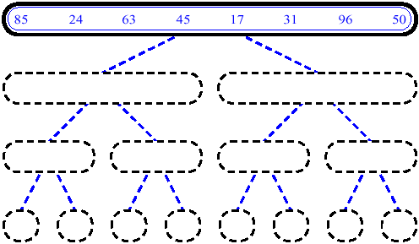
MergeSort (Example) - 1

Slide 27
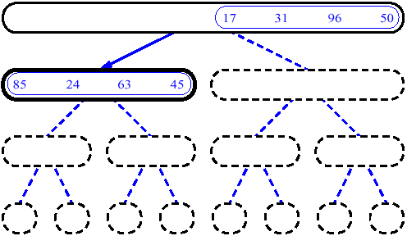
MergeSort (Example) - 2

Slide 28
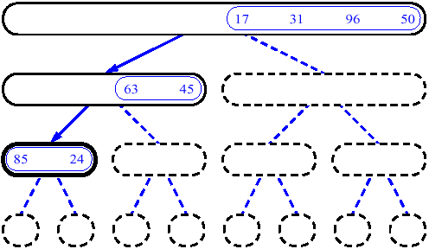
MergeSort (Example) - 3

Slide 29
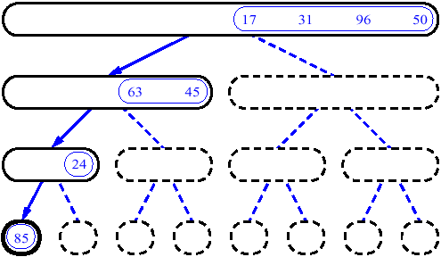
MergeSort (Example) - 4

Slide 30
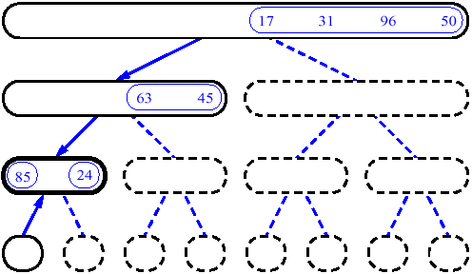
MergeSort (Example) - 5

Slide 31
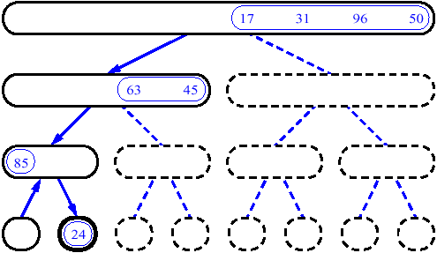
MergeSort (Example) - 6

Slide 32
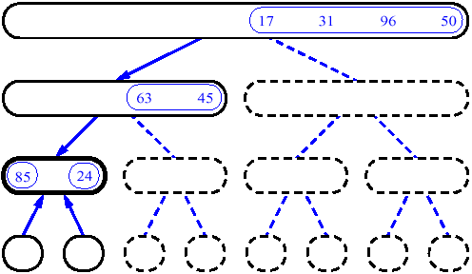
MergeSort (Example) - 7

Slide 33
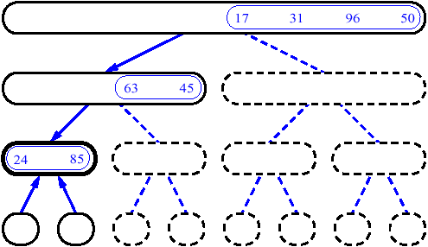
MergeSort (Example) - 8

Slide 34
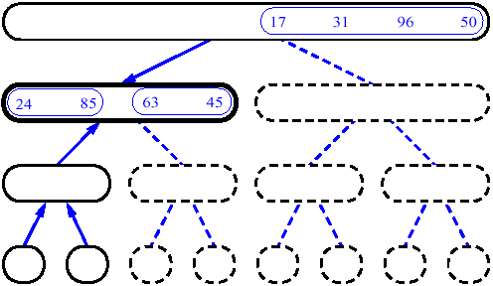
MergeSort (Example) - 9

Slide 35
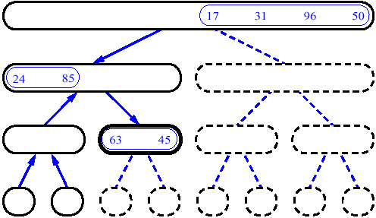
MergeSort (Example) - 10

Slide 36
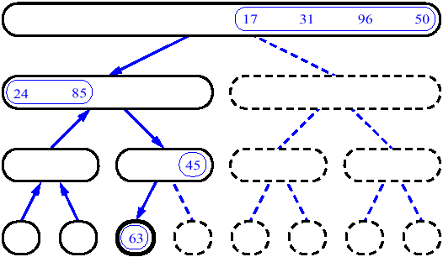
MergeSort (Example) - 11

Slide 37
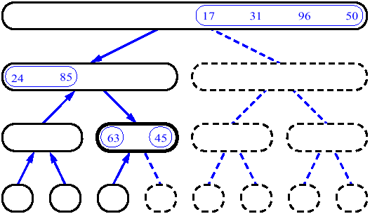
MergeSort (Example) - 12

Slide 38
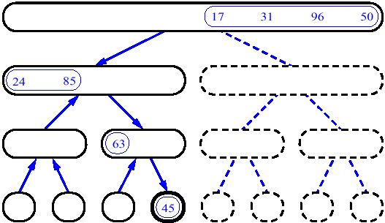
MergeSort (Example) - 13

Slide 39
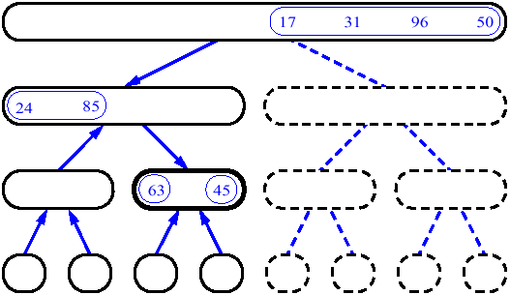
MergeSort (Example) - 14

Slide 40
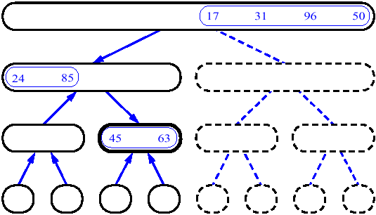
MergeSort (Example) - 15

Slide 41
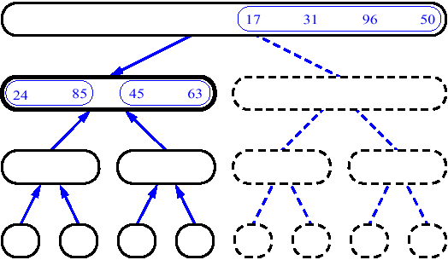
MergeSort (Example) - 16

Slide 42
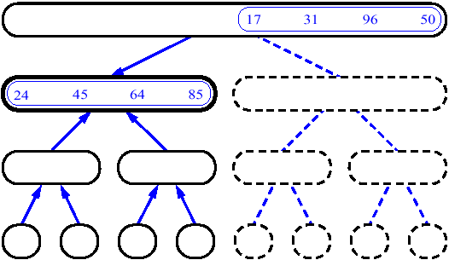
MergeSort (Example) - 17

Slide 43
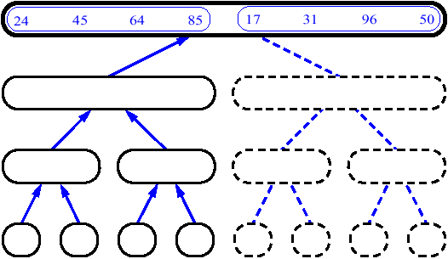
MergeSort (Example) - 18

Slide 44
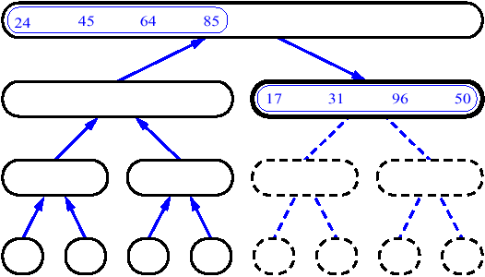
MergeSort (Example) - 19

Slide 45
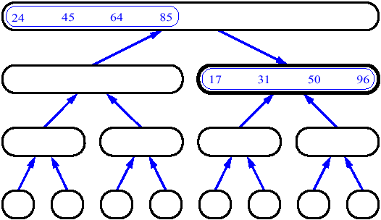
MergeSort (Example) - 20

Slide 46
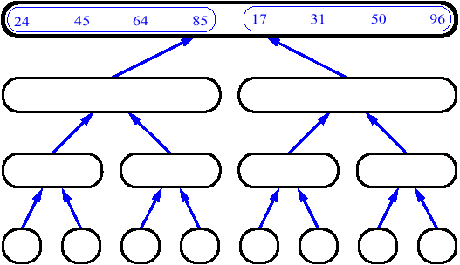
MergeSort (Example) - 21

Slide 47
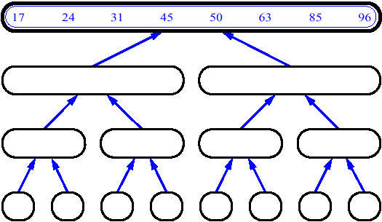
MergeSort (Example) - 22

Slide 48
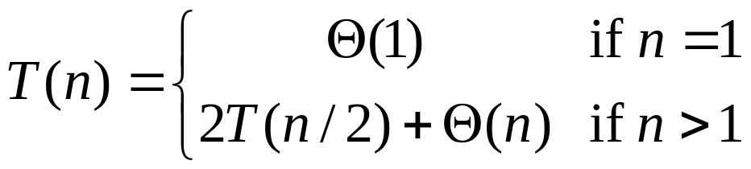
Recurrences
Recursive calls in algorithms can be described using recurrences
A recurrence is an equation or inequality that describes a function in terms of its value on smaller inputs
Example: Merge Sort

Slide 49
Next Week
Solving recurrences

Slide 50
Lecture Summary
Proving that an algorithm is totally correct means:
  Proving that it will terminate
  Proving that the list of actions applied to the precondition imply the postcondition
How to prove repetitive algorithms:
  Iterative algorithms: use Loop invariants, Induction
  Recursive algorithms: use induction using as hypothesis the recursive call

